Slide 1

High School Help & Planning
Empowering Families
Notes:
Welcome! We are excited you are here today. Our goal is to equip you with knowledge so you can plan and guide your student through the high school years. My name is Rachel Abel and I occasionally help out here at CEDAR. A little about me: I have an undergraduate and masters degree in Special Education. I worked in the public schools for 15 years. I have taught every grade from K-5. I spent 8 years as an Educational Diagnostician. Where I completed testing for disabilities, created educational plans for students, managed teachers and staff. Additionally, I have been an adjunct professor of education, and an educational consultant. 7 years ago I became a home education mom as well. I have 3 children, my daughter just graduated from UCF on Aug 2 and is now in graduate school, My son is a senior here at CEDAR at will be graduating in December, and my youngest is 14 and in 9th grade.

Slide 2

Topics Covered
Understanding of Law
Best Record Keeping Practices
Graduation Requirements
Home Expectations
Transcripts
Preparing for College, Scholarships and Financial Aid
Course Planning
Notes:
Whole to part , plan for your student,

Slide 3


Understanding The Laws
Florida has some of the loosest home education laws in the U.S., giving parents freedom to craft an education that best suits their family.
Florida does not have a set of minimum skills, education level, or required subjects.
Florida does require that parents provide sequentially progressive instruction in order satisfy Florida’s compulsory education requirements. In addition, home educated students must have an annual evaluation to show their educational progress.
Progress can look very different for each student which is why documentation is important (We will cover this later).
Notes:
you can see as a home educator parents have a lot of leeway in crafting their child’s education This so all types of learners are included. Think of everyone’s functioning as a spectrum. Einstein at one end and someone very limited with disabilities at the other end. The law has to be broad enough to encompass both and everyone in between. So lets use lollipops as our example: a student with severe disabilities' progressive instruction might be being able to independently eat a lollipop and dispose of the trash at the other end, someone might be learning the chemical bonds of cooking sugar to make a lollipop. Sequentially progressive instruction should be the SEQUENTIAL. Buy the sugar, learn to cook, learn to mold, wrap etc. Progress can be year 1 eating the candy, year 2 making the candy, year 3 understanding the chemistry, etc.

Slide 4
Best Record Keeping Practices
In Florida, parents are required to keep a home education portfolio. This should include:
Work samples
Writings
Quizzes
Log of educational activities
Parents are required to keep the portfolio for two years, but interestingly you don’t have to share it with the school district unless specifically requested in writing! For high school, we recommend holding on to tests, quizzes, and ALL writing assignments. Some colleges do ask to see documentation.
Some examples:
Workbooks
Pictures of projects
Any paperwork generated through assignments and assessments.
This can also be print outs of grades from CEDAR classes.
Notes:
We are still in the airplane and have not landed yet. Record keeping is critical. This information may be needed for college applications

Slide 5

Annual Evaluations
The state indicates any one of the following are acceptable for annual evaluations:
A state-approved psychologist assessment.
A state-normed test administered at an approved testing center.
A certified Florida teacher can review the student portfolio.
A state-normed test administered by a certified Florida teacher, which CEDAR provides the opportunity for every year.
This Photo by Unknown Author is licensed under CC BY-NC
Notes:
We have included the Broward Annual evaluation forms on the CEDAR website. A benefit of CEDAR is we provide the annual evaluations for an additional fee every June.

Slide 6
Florida Home Education
Graduation Requirements
A home education diploma is completely valid.
Parents determine the requirements for graduation.
While parents determine the requirements for graduation, it is WISE to consider a few factors:
If college is the end goal, your high school experience should align with college entrance requirements.
It is also helpful to look at the guidelines that public schools follow in Florida.
When you look at both the public-school requirements and college entrance requirements there are some common courses and tests to include.
This Photo by Unknown Author is licensed under CC BY-NC
Notes:
Still up in the air. Lets look at what our state requires to graduate. You should look at this slide through the lens of “just because you can doesn’t mean you should”. Always remember the parent writes the transcript. Your home education evaluation is completely valid and legal. No can tell you otherwise!

Slide 7
Florida Diploma Requirements Public vs home education
Florida diploma requirements for public/private schools. | Standard diploma=24 credits and a 2.0 grade point average on a 4.0 scale | Home education: Parents determine graduation requirements
Florida High School course credits | English- 4 Credits Math- 4 credits Science-3 credits Social Studies-3 credits P.E.-1 credit Fine Arts-1 credit Electives-8 credits Online Course-1 credit *This is for a standard diploma. There are other tracks for more rigorous diplomas | Show sequentially progressive instruction in order satisfy Florida’s compulsory education requirements
Florida High school transcripts | Public school transcripts must include: Identifying information Standardized test scores Credit totals Cumulative GPA Credit history that includes course titles, grades received by semester | A record of all learning
Notes:
The Florida standard requirements line up wit the college entrance requirements and that is important information!

Slide 8
Transcript
General guidelines
Transcripts will be critical for future education beyond your home.
An ideal transcript should not be longer than two pages.
There are a lot of free transcripts available on the web.
Most Florida universities prefer a subject transcript over a yearly transcript.
CEDAR has an editable transcript available for you on the website, under the enrolled parents tab.
Oofficial transcripts (and if they are final, note that as well)
Show the grade point average based on grades and weighted credits
No spelling/grammar errors
Printed on good quality paper
Signed either at the top of the first page or the bottom of the last page by the school administrator (you!)
Transcripts should be in a sealed envelope with a signature across the seal, then put into a larger envelope and mailed
This Photo by Unknown Author is licensed under CC BY-NC

Slide 9
Transcript Must-Haves
A home education transcript should include:
Student's name
Your home education name
Your home education address (usually your home)
Your phone number
Student's date of birth
Graduation date (use projected graduation date for pre-graduation submissions)
Section for each subject area in which high school courses were completed, with the information below included for each individual course
Number of credits (both cumulative and, if organized by year, for each year)
GPA (both cumulative and, if organized by year, for each year)
Grading scale
Notes:
There is a transcript available on the CEDAR website.

Slide 10
Course Descriptions
For each course on your transcripts, you should include:
Course name, year completed, Text/ISBN number, method, instructor
Grade earned for each course
Course weight (if additional weight is given) for each course
Number of credits for each course
GPA for each course
Course code from the Florida DOE or the college course code
Where taken should be listed

Slide 11
Course Descriptions
Course Descriptions should include a detailed description of each class taken for high school credit, no matter where taken.
The description should include the names of books, resources, and any materials.
In addition, it should describe topics studies, projects, and important information.
The reader should be able to walk away with an understanding of what skills were mastered.
Some Ideas for Course Descriptions.
Create a word document for each student with course descriptions.
For CEDAR courses, copy the descriptions from the website.
Keep a printout of the individual grades from each CEDAR course, which can be very diagnostic for a parent.
Notes:
sequentially progressive instruction in order satisfy Florida’s compulsory education requirements

Slide 12
Graduation
&
Affidavit of Completion
An Affidavit of Completion, when signed by a parent and notarized, is legal proof of high school graduation in Florida.
An evaluation must be submitted with the letter of termination (or within 30 days of it) to the home education office of the school district. This requirement, which took effect in July 2018, was enacted so the home education office can verify to a college or organization the student is graduated.
The final evaluation is exactly the same as an annual evaluation.
Don’t forget! Every family must fill out the FAFSA before attending college

Slide 13

what you do is a result of what you are
Parents set the tone for high school. How you handle the day to day expectations will greatly impact the level of skill mastery your students will get out of CEDAR
This Photo by Unknown Author is licensed under CC BY

Slide 14

Home Expectations for CEDAR HIGH SCHOOL
One of the goals of home educating through high school is independence. In high school, students should be fairly independent working through assignments. That should look like:
Being able to ask for help, clarify, and understand an assignment
Using resources, including adults, to further explain a skill
Completing assigned work on time
Communicate struggles with your CEDAR instructors
Learn to self-advocate. NOT THE PARENT
PARENTS- grade work DAILY, you are the home educator

Slide 15
For Students Who Struggle Academically
If an assignment/class is too much for your student, you might need to ask for help. A tutor, a peer, and family member. A curriculum/class is a finite set of skills/information to be learned.
Your student is not behind. Parents set the requirements for graduation, the pacing, and the timelines. Some students need an extra year of high school to mature.
College is not the only path to take! If you have a student who struggles with academics, why send them to a situation that will be difficult for them?
Notes:
Super Senior Year: Hold them back early, so the district won’t push you to graduate them sooner.
Parents decide how quickly your student must complete a given course.

Slide 16

Consistency is key
. 90% of the work done in this country is done by people who don’t feel well,
T. Roosevelt

Slide 17

Preparing for College
Skills parents can foster while their student is a CEDAR to prepare them for success in college:
  Time management. Allow student to experiment with their own work schedule and habits in the safety of your home education environment. If the student fails at home, you can come beside them and help them develop theses skills which are essential for college success. This should look different for a freshman than a senior.
    *CEDAR expects that work is graded DAILY by the PARENT, so the parent can diagnostic
  Best work the first time: Most college courses don’t allow work be re-done typically. Guide your students towards this as they age.
  Dual enrollment: This is a great way to get your student used to college expectations, while you are still available for accountability and support. It is a great testing ground before you spend a lot of money on college tuition.
  1. Explain to student how the syllabus is like the owner’s manual for the course.
  2. keep a calendar of the whole semester assignments.
  3. Assignments are often embedded in the courses & it is the students’ assignment to be prepared
Notes:
Parents need to put on their instructor hat when grading. Why is work wrong? Didn’t understand, poor quality, struggling with the format of the assignment. It is your job to diagnose and remediate. Time management: First give the work for 2 days if not done, reduce, if not done give them a time to be completed by, then sit with them. Always be looking for the root cause. Are they struggling with the subject in general, the unit of study, the type of assignment?
SUPER SENIOR YEAR

Slide 18
Preparing for College Scholarships and Financial Aid
The BEST way to obtain a scholarships as a home educated student is by achieving good test scores on the ACT, SAT, and/or CLT.
Even in these times when many schools are going test-optional, a student with high scores WILL get corresponding scholarship money.
It's hard to know exactly how the test-optional schools are evaluating your student in comparison to other applicants. Standardized tests are a way to remove many of the variables and prove that your student deserves a scholarship.
Start tutoring and utilize resources early!
Notes:
Home education is a bit of a wild card for colleges. The standards can vary a lot between public high schools and to an admission officer there is even more variance. Test score match the transcript.

Slide 19
Test Prep Courses
There are many local, in-person, test prep companies and individual tutorials. Most of which are covered by the PEP scholarship.
Some other options are:
Mr. D’s math test prep bootcamp on-line. He offers both the ACT and the SAT courses.
Khan Academy test prep is written and endorsed by The College Board. Research shows that 20 hours of Khan raises scores as much as an in-person course, and its free!

Slide 20
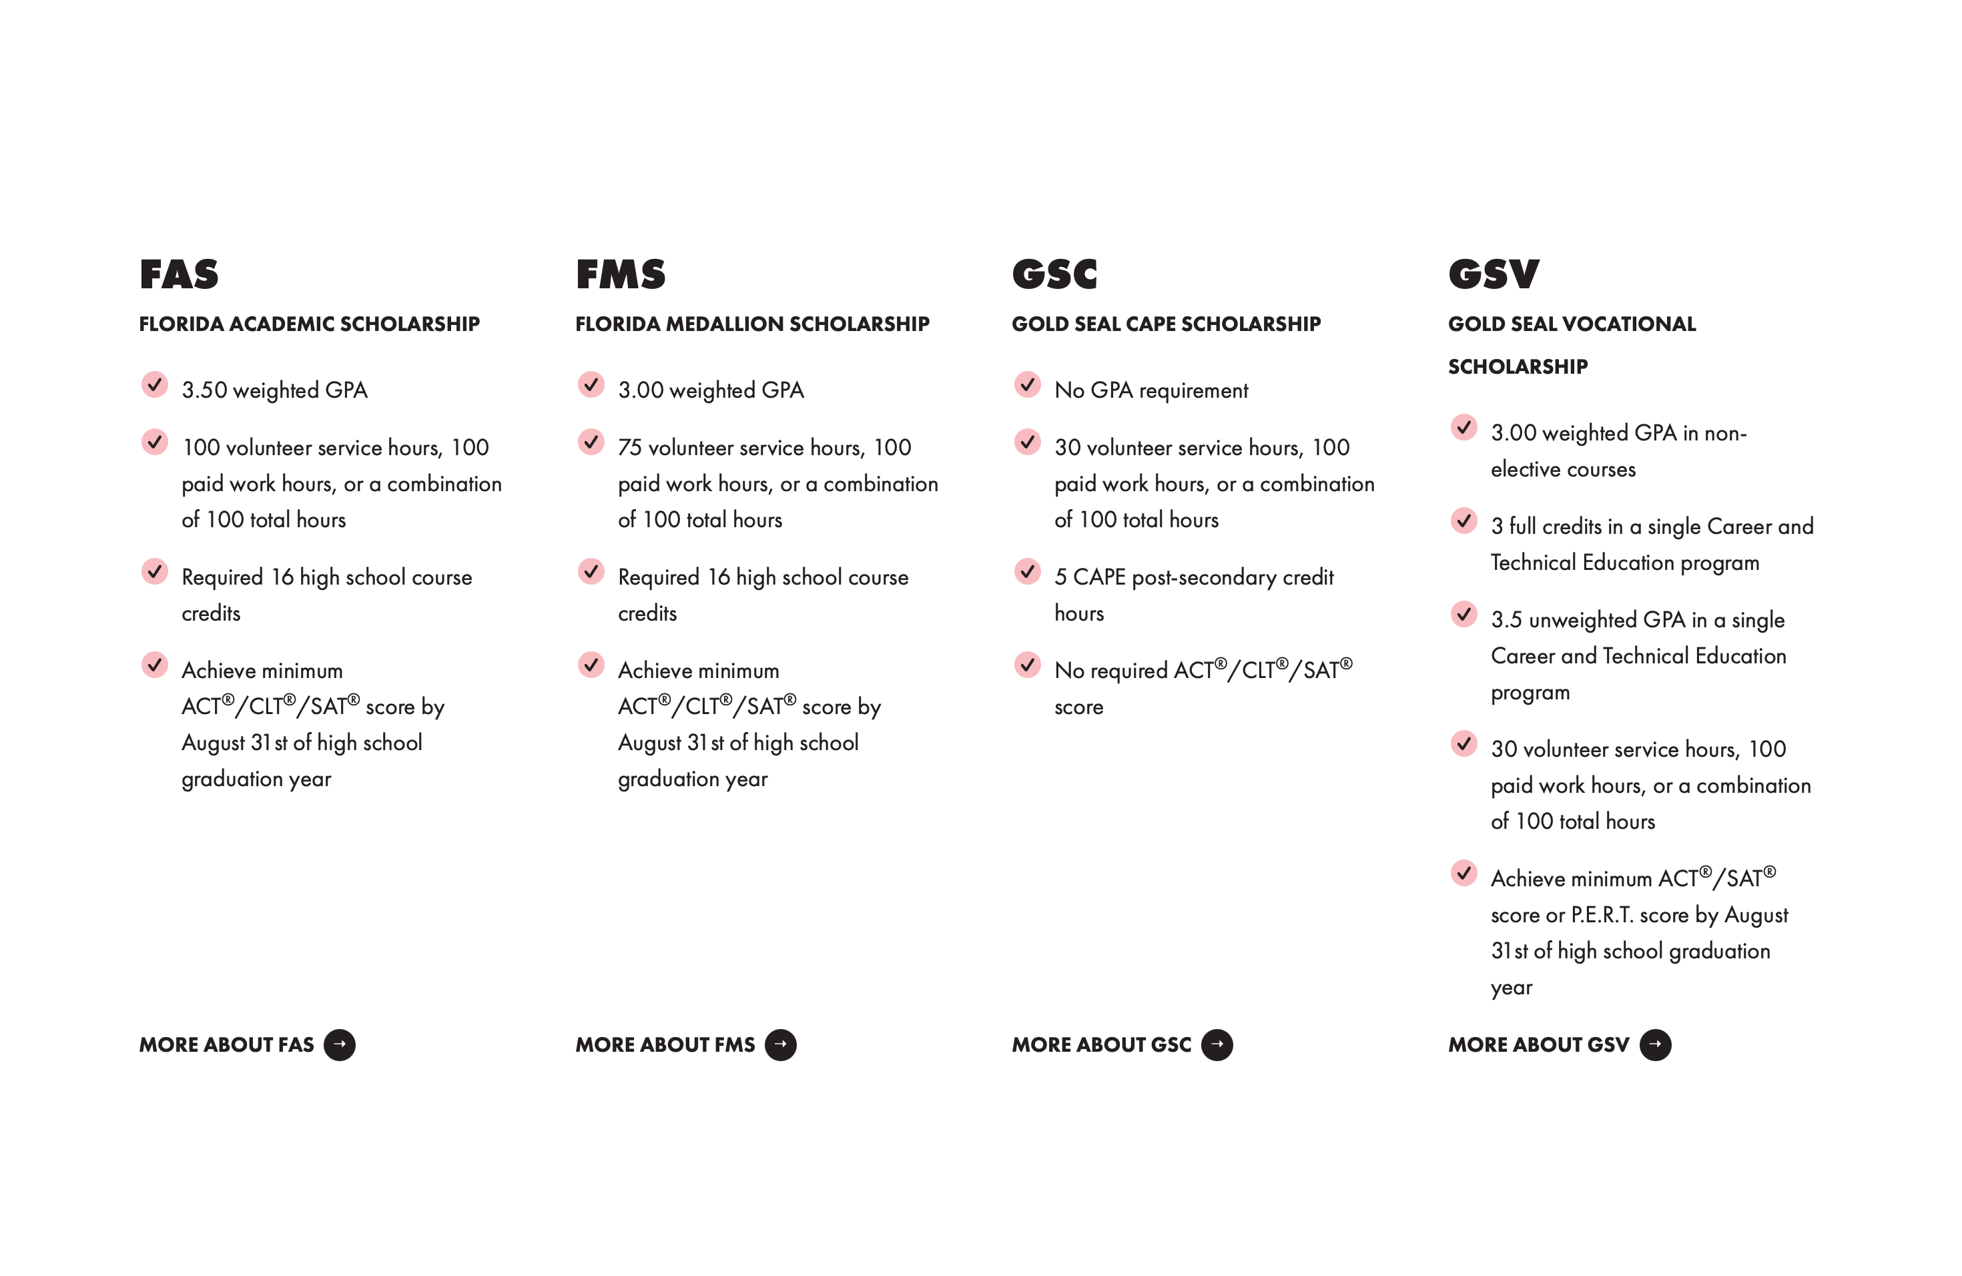
Bright Futures
There are 2 levels of Bright Futures 75% and 100% (Medallion) scholarship.
Notes:
On the BF there are additional scholarships available. It is well worth your time to look through the other available scholarships.
If you can complete CEDAR you are college bound. Just like there are difficult universities are easier ones too. That is why a good match is important

Slide 21
COURSE Planning
1. English
2. Math
3. Science
4. History
5.Electives
Notes:
The website now has many links and resources for you.
We would like to have you plan high school. Lets go through subject by subject.
Talk about financial course
Computer course
Aim for 3 years of foreign language

Slide 22
Outside of cedar suggestions
FLVS –Computer Science and Financial Literacy Courses
7Sisters home education- Health
Dave Ramsey- Entrepreneurship and any other courses
Fundafunda Academy- Photography, Mini Units
BJU Academy-Any course
The Potters School

Slide 23
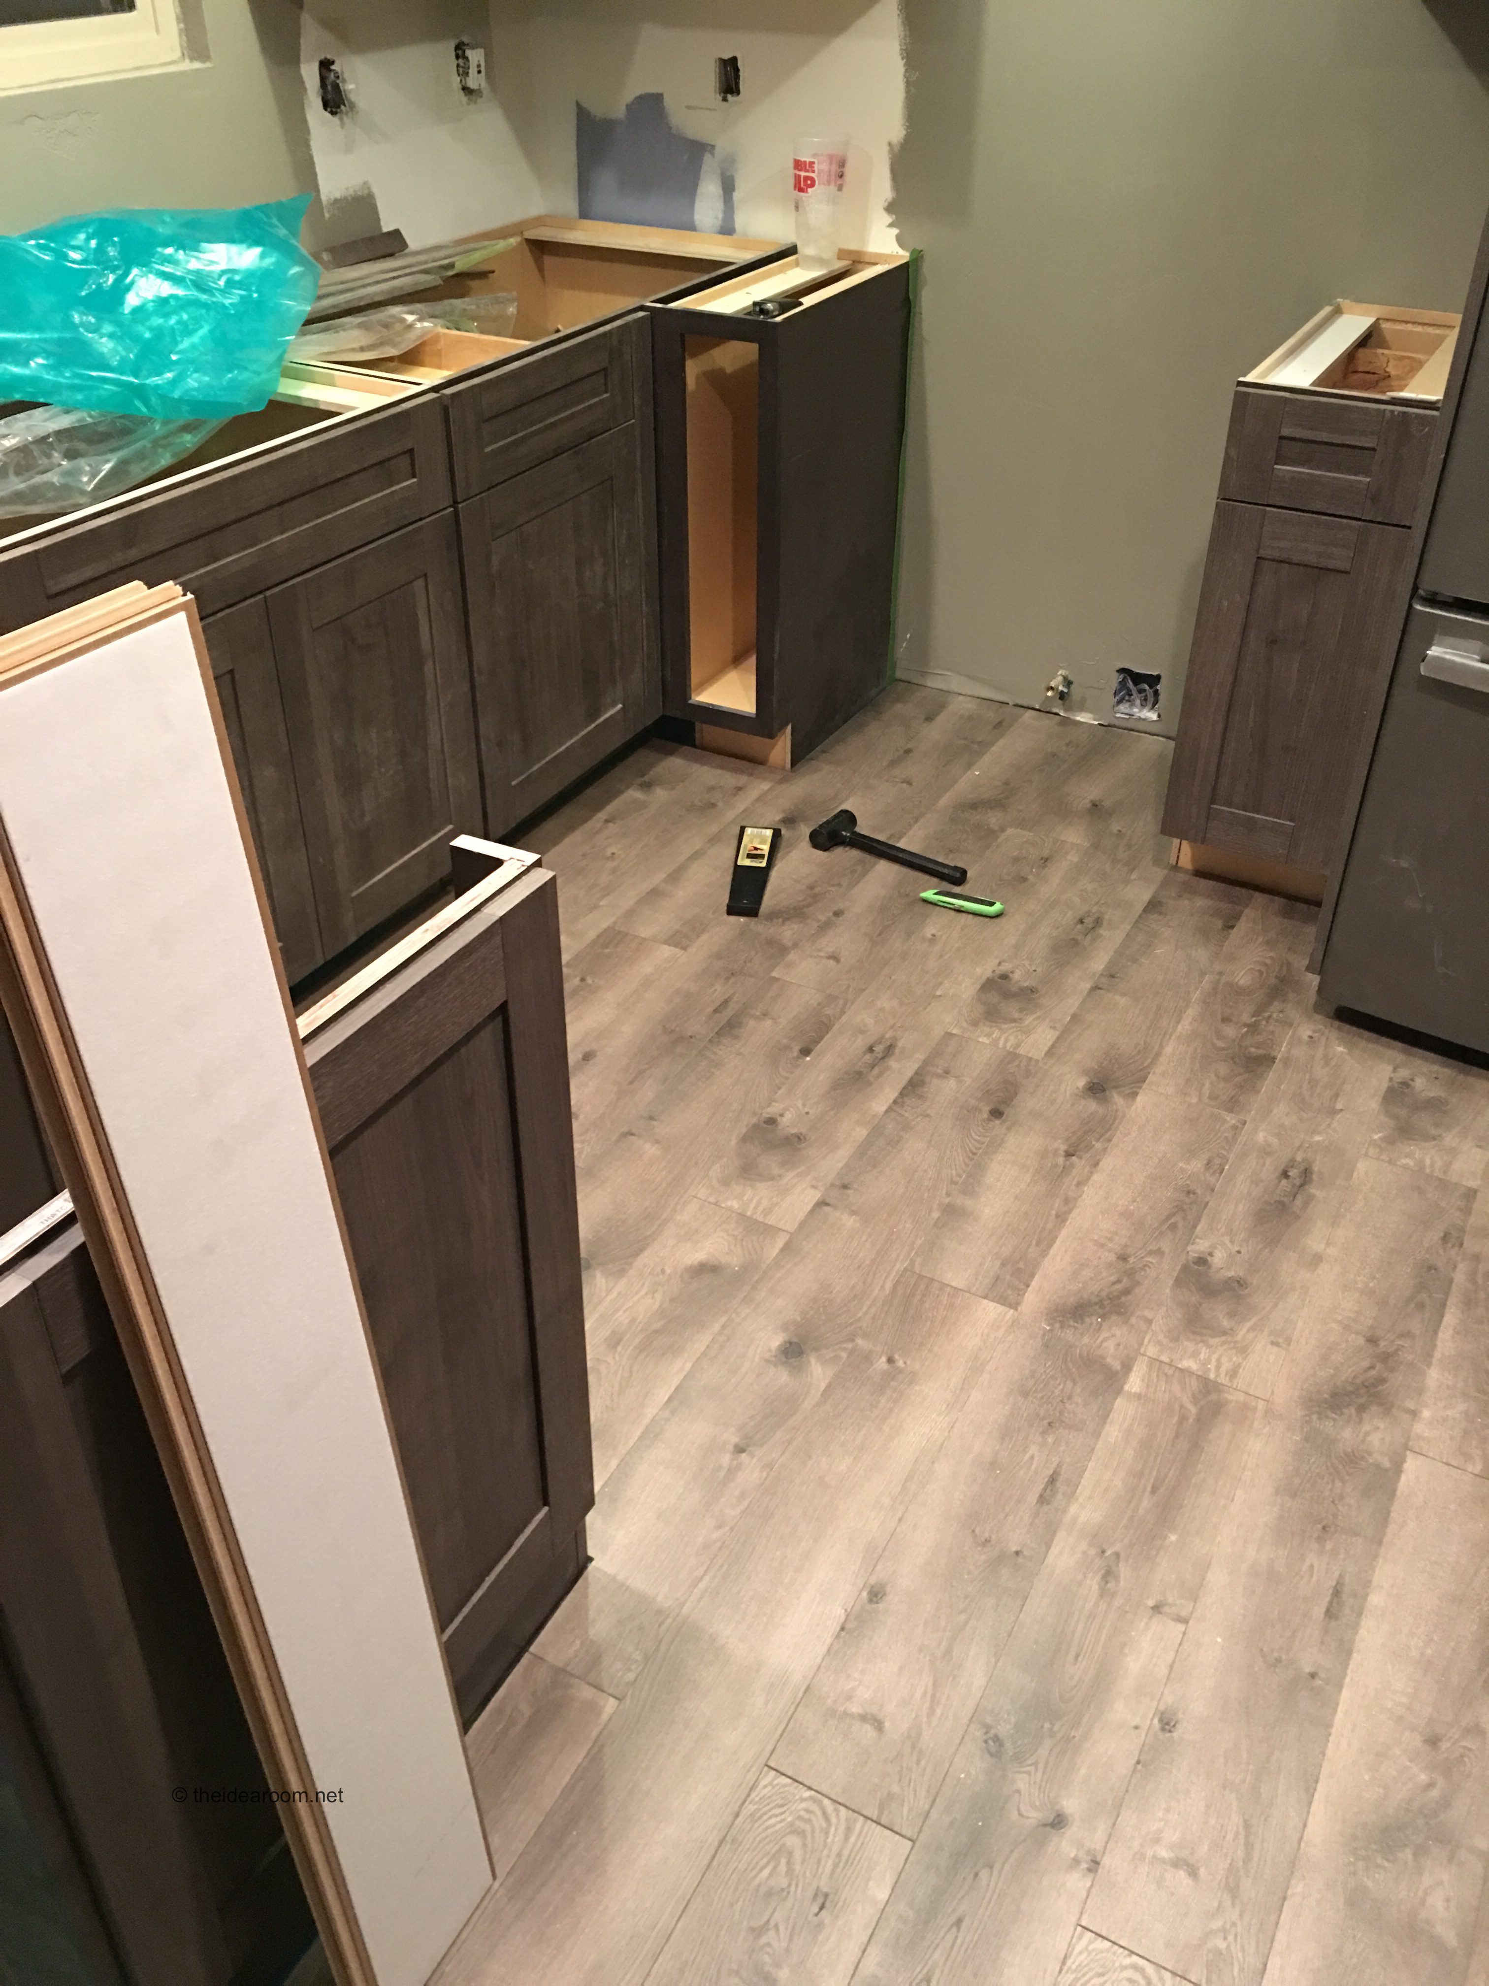
Internships
Try
Try to craft a few, short or long term internships for your student in their general areas of interest
Consider
Consider apprenticing under a trade:
Look
Look at who is in your circle that can provide some learning
This Photo by Unknown Author is licensed under CC BY-NC-ND

